Slide 1
The 2030 Agenda
The inclusion of persons with disabilities
Introductory toolkit

Slide 2
Introduction
The International Disability Alliance (IDA) advances the human rights of persons with disabilities as a united voice of four regional and eight global organizations of persons with disabilities (DPOs).
The International Disability and Development Consortium (IDDC) is a global network of 26 disability and development NGOs and organizations of persons with disabilities working in more than one hundred countries around the world.
Both IDA and IDDC members have been active in the process that shaped the 2030 Agenda
This guide presents information about the 2030 Agenda, how it connects to the United Nations Convention on the Rights of Persons with Disabilities (UN CRPD) and explores ways for persons with disabilities to be influential and participate in how they are achieved.

Slide 3
ONE
What is the 2030 Agenda?

Slide 4
What is the 2030 Agenda?
The 2030 Agenda is the result of years of negotiations at the UN between governments, called the‘post-2015 process’.
It intends to replace – and build – on the Millennium Government Goals which lasted from 2000 to 2015
The 2030 Agenda is a political commitment of the governments of all 193 Member States of the United Nations (UN).

Slide 5
What is the 2030 Agenda?
The 2030 Agenda is a commitment by Governments to:
  build a better future for all people, including millions who are currently denied the chance to lead decent, dignified and rewarding lives and to achieve their full human potential;
  succeeding in ending poverty, reducing inequalities, and saving the planet from ecological degradation and climate change

Slide 6
What is the 2030 Agenda?
The 2030 Agenda is a 35-page document containing five sections (including the SDGs):
Preamble
Declaration
Sustainable Development Goals and targets
Means of implementation and the Global Partnership
Follow-up and Review

Slide 7
What is the 2030 Agenda?
It is important to understand that although the 2030 Agenda is a global commitment, it is not legally binding.
The translation of the 2030 Agenda into policies will vary significantly in different countries.
This is a result of the political balance of the Agenda, which can be summarized as:
  Universal Ambition vs. National Ownership
  “This is an Agenda of unprecedented scope and significance. It is accepted by all countries and is applicable to all, taking into account different national realities, capacities and levels of development and respecting national policies and priorities...” - 2030 Agenda, para 5

Slide 8
What is the 2030 Agenda?
The overarching principle of 2030 Agenda is:
Leave No One Behind
This means to ensure its success, the Agenda must remain of the people, by the people and for the people, committing the world to global action for the next 15 years.
This echoes our movement’s own principle:
Nothing About Us Without Us

Slide 9
TWO
Where are Persons with Disabilities in the 2030 Agenda?

Slide 10
Where are Persons with Disabilities in the 2030 Agenda?
The following few slides will explain how persons with disabilities are both referenced multiple times and important to the entire 2030 Agenda.

Slide 11
Inclusion
Where are Persons with Disabilities in the 2030 Agenda?
Persons with disabilities were not referenced in the Millennium Development Goals (MDGs). This means they were excluded from many important development initiatives and funding streams around the world.
The 2030 Agenda does include persons with disabilities. This means it presents a great opportunity and responsibility for persons with disabilities.

Slide 12
Where are Persons with Disabilities in the 2030 Agenda?
Millennium Development Goals (MDGs) | 2030 Agenda
Adopted in 2000 and ended in 2015 | Adopted in 2015 and ends in 2030
Focused on developing countries | Universal, applies to all countries
To reduce extreme poverty | To eradicate poverty in all its forms and and to realize economic empowerment through sustainable development
8 goals, with 18 targets and 48 indicators | 17 Goals, which include a total of 169 targets (all measured using 231 global indicators)
No references to persons with disabilities | 7 references to persons with disabilities: education (2), employment, reducing inequalities, inclusive cities (2), disaggregation of data by disability. Total of 11 in the 2030 Agenda and 9 global indicators

Slide 13
Where are Persons with Disabilities in the 2030 Agenda?
Persons with disabilities are referenced directly 11 times in the 2030 Agenda:
Declaration
  Human rights (paragraph 19)
  Vulnerable groups (paragraph 23)
  Education (paragraph 25)

Slide 14
Where are Persons with Disabilities in the 2030 Agenda?
Sustainable Development Goals
  Goal 4: Education – 2 references
  Goal 8: Employment
  Goal 10: Reduce inequality
  Goal 11: Inclusive cities – 2 references
  Goal 17: Means of implementation, data
  Follow-up and review
  Data disaggregation (paragraph 74,g)

Slide 15
Where are Persons with Disabilities in the 2030 Agenda?
“People who are vulnerable must be empowered. Those whose needs are reflected in the Agenda include all children, youth, persons with disabilities (of whom more than 80 per cent live in poverty)”
- paragraph 23
This paragraph is particularly strong because it calls for the empowerment of “vulnerable” people and places persons with disabilities at the centre of poverty eradication throughout the entire Agenda.

Slide 16
Where are Persons with Disabilities in the 2030 Agenda?
Including persons with disabilities among vulnerable people means that whenever “vulnerable” is referenced throughout the Agenda (18 times), these provisions directly apply to persons with disabilities.
The disability movement prefers the term “at risk” rather than “vulnerable,” but “vulnerable” is more broadly accepted by governments at the UN. Due to the political sensitivity of the 2030 Agenda negotiations it was not possible to change this term.

Slide 17
THREE
What are the Sustainable Development Goals?

Slide 18
What are the Sustainable Development Goals?
The SDGs were created to guide all countries to achieve sustainable development by 2030
“Sustainable development recognizes that eradicating poverty in all its forms and dimensions, combating inequality within and among countries, preserving the planet, creating sustained, inclusive and sustainable economic growth and fostering social inclusion are linked to each other and are interdependent.”
- 2030 Agenda, para 13

Slide 19
What are the Sustainable Development Goals?
The SDGs are universal meaning that they apply to all countries.
There are 17 Goals complemented with 169 targets.
Due to national ownership, the implementation of the SDGs into national planning, policies and strategies will vary significantly in different countries.
One size does not fit all; there are different approaches, visions, models and tools in each country to achieve sustainable development.

Slide 20
What are the Sustainable Development Goals?
1. End poverty in all its forms everywhere
2. End hunger, achieve food security and improved nutrition and promote sustainable agriculture
3. Ensure healthy lives and promote well-being for all at all ages
4. Ensure inclusive and equitable quality education and promote lifelong learning opportunities for all
5.Achieve gender equality and empower all women and girls
6. Ensure availability and sustainable management of water and sanitation for all
7. Ensure access to affordable, reliable, sustainable and modern energy for all

Slide 21
What are the Sustainable Development Goals?
8. Promote sustained, inclusive and sustainable economic growth, full and productive employment and decent work for all
9. Build resilient infrastructure, promote inclusive and sustainable industrialisation and foster innovation
10. Reduce inequality within and among countries
11. Make cities and human settlements inclusive, safe, resilient and sustainable
12. Ensure sustainable consumption and production patterns
13. Take urgent action to combat climate change and its impacts (acknowledging that the United Nations Framework Convention on Climate Change is the primary international, intergovernmental forum for negotiating the global response to climate change)

Slide 22
What are the Sustainable Development Goals?
14. Conserve and sustainably use the oceans, seas and marine resources for sustainable development
15.Protect, restore and promote sustainable use of terrestrial ecosystems, sustainably manage forests, combat desertification, and halt and reverse land degradation and halt biodiversity loss
16.Promote peaceful and inclusive societies for sustainable development, provide access to justice for all and build effective, accountable and inclusive institutions at all levels
17. Strengthen the means of implementation and revitalise the global partnership for sustainable development

Slide 23
FOUR
How are the SDGs inclusive of persons with disabilities?

Slide 24
How are the SDGs inclusive of persons with disabilities?
13 Goals have a direct impact on the lives of persons with disabilities
Wherever “vulnerable groups” are mentioned in the targets, this means it includes persons with disabilities
The inclusive phrasing of many Goals and targets also makes them applicable for persons with disabilities, such as those referencing “for all” or “all women and men”
Even without any such references, all Goals and targets will be applicable to persons with disabilities because of the 2030 Agenda’s overarching principle of leave no one behind

Slide 25
All Goals and targets are related to persons with disabilities
How are the SDGs inclusive of persons with disabilities?
Entire 2030 Agenda includes principle of ‘Leave No One Behind’
All inclusive language links to persons with disabilities
7 explicit references to persons with disabilities
18 references to ‘vulnerable populations’

Slide 26
FIVE
How do the SDGs connect to the UN CRPD?

Slide 27
How do the SDGs connect to the UN CRPD?
The SDGs are capable of transforming the lives of persons with disabilities
So persons with disabilities should aim for the SDGs to be achieved with them, by them and for them
To achieve a disability-inclusive society, persons with disabilities must work with their governments so that the SDGs are implemented in line with the UN CRPD
The SDGs should also be consistent with and build upon existing international and national commitments and accountability processes, including the UN CRPD

Slide 28
How do the SDGs connect to the UN CRPD?
The SDGs draw specific attention to persons with disabilities – the MDGs did not
The SDGs sets specific commitments to governments to empower persons with disabilities which are also found in the UN CRPD
Therefore, the UN CRPD should serve as a guiding framework for implementing the SDGs
Inclusion and the rights of persons with disabilities can only be ensured by applying the UN CRPD to the implementation of the SDGs. This will prevent the creation and perpetuation of institutional, attitudinal, physical and legal barriers, and barriers to information and communication technology (ICT), among other barriers to the inclusion and participation of persons with disabilities.

Slide 29
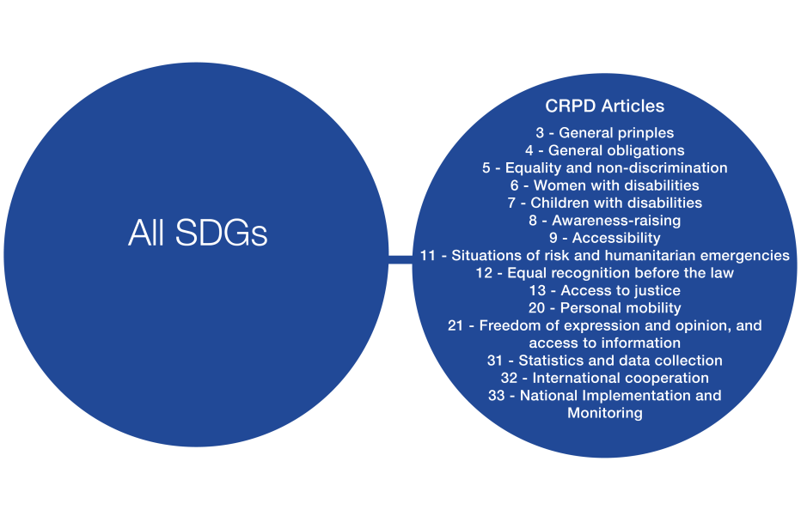
Several UN CRPD Articles are cross-cutting in nature and must always be applied and/or considered for the implementation of every Goal and target. Some examples are included below.

Slide 30
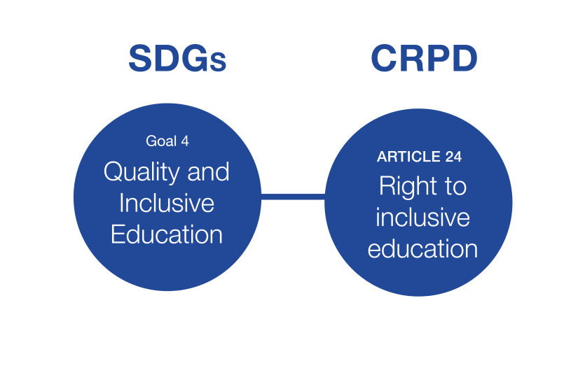
Example: Goal 4
Quality and Inclusive Education

Slide 31
Example: Goal 4
Quality and Inclusive Education
What it means for persons with disabilities:
  Ensure that all girls and boys:
    complete free, equitable and quality primary and secondary
    have access to quality early childhood development, care and pre-primary education
    have equal access to affordable and quality technical, vocational and tertiary education, including university
  Eliminate gender disparities in education and ensure equal access to all levels of education and vocational training for the vulnerable, including persons with disabilities
  Build and upgrade education facilities that are child, disability and gender sensitive
When is the goal achieved for persons with disabilities?
  When inclusive, accessible and quality education for children and persons with disabilities is realized at all levels (primary, secondary, tertiary, and vocational training) leading to relevant and effective learning outcomes

Slide 32
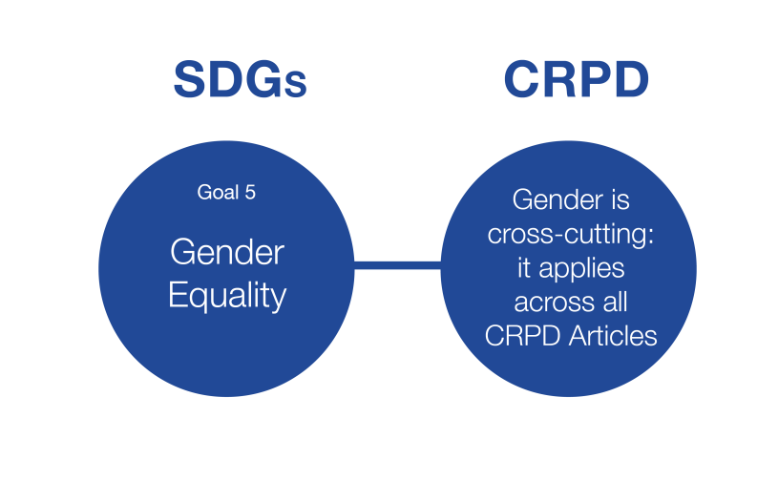
Example: Goal 5
Gender Equality

Slide 33
Example: Goal 5
Gender Equality
What it means for persons with disabilities:
  End all forms of discrimination against all women and girls everywhere
  Eliminate all forms of violence
  Eliminate all harmful practices, such as child, early and forced marriage and female genital mutilation
  Ensure women’s full and effective participation and equal opportunities for leadership at all levels of decision-making in political, economic and public life
  Ensure universal access to sexual and reproductive health and reproductive rights
When is the goal achieved for persons with disabilities?
  To end violence and discrimination towards girls and women with disabilities or towards women with children with disabilities, to ensure that both are not excluded from society and treated equally

Slide 34
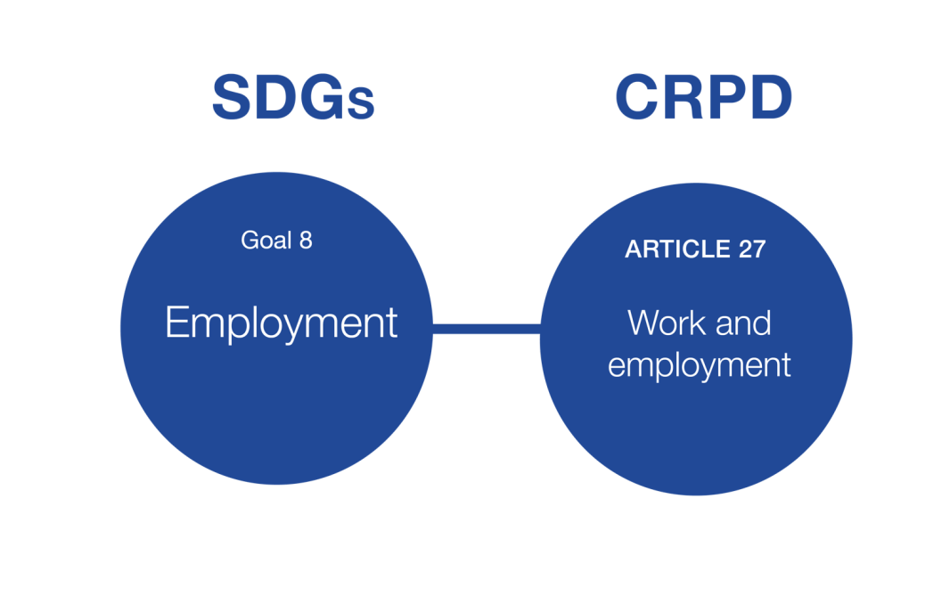
Example: Goal 8
Employment

Slide 35
Example: Goal 8
Employment
What it means for persons with disabilities:
  Promote development-oriented policies that support productive activities, decent job creation, entrepreneurship, creativity and innovation, and encourage the formalization and growth of micro-, small- and medium-sized enterprises, including through access to financial services
  Achieve full and productive employment and decent work for all women and men, including for young people and persons with disabilities, and equal pay for work of equal value
When is the goal achieved for persons with disabilities?
  The expansion of anti-discrimination provisions in labour and labour-related laws
  The realization for reasonable accommodation and creating more inclusive mainstream initiatives to promote full and productive employment for persons with disabilities
  Access to training and vocational education courses
  Access to bank loans and micro-finances to start-up businesses

Slide 36
SIX
How can persons with disabilities engage in the SDGs?

Slide 37
How can persons with disabilities engage in the SDGs?
“Persons with disabilities were instrumental in creating this transformational roadmap to a better future. Now the hard work of real change lies directly ahead. Persons with disabilities must be leaders, guiding the world towards achieving these goals for everyone. This journey demands our persistent and unwavering duty to hold our governments accountable to their own commitments.
We cannot afford to be left behind again.”
  - Maryanne Diamond, Chair of the International Disability Alliance, 2015

Slide 38
How can persons with disabilities engage in the SDGs?
The participation of persons with disabilities in the implementation of the SDGs is critical and will serve as a litmus test to whether the SDGs achieve what the MDGs failed to achieve for persons with disabilities.
Persons with disabilities must engage with their governments and monitor the implementation of the SDGs so that they are for them, by them and with them.
At the global level, persons with disabilities have a role in the oversight of governments’ commitments to the SDGs as stakeholders.

Slide 39
How can persons with disabilities engage in the SDGs?
CRPD monitoring should inform SDG monitoring and vice-versa.
A parallel report for the CRPD is also a great resource an SDG parallel report
Data generated by States and development agencies for SDG monitoring can be contribute to CRPD monitoring.
The same applies to UPR, CEDAW, and CRC

Slide 40
How can persons with disabilities engage in the SDGs?
Global Advocacy
Participate in the global coordination mechanism established for persons with disabilities
Contribute to annual, thematic and national reviews
Regional Advocacy
Share knowledge
Participate in peer review
Form and develop regional collaboration and projects
National Advocacy
Prepare parallel and shadow reports
Provide expert knowledge and engagement
Participate in government-led consultations
Partner with civil society, academia, stakeholders and UN agencies

Slide 41
How can persons with disabilities engage in the SDGs?
National level engagement
DPOs can get engaged both locally and with their governments, working both independently and in alliances with other stakeholders to reinforce messages and support each other
Different strategies will be required in different national contexts
It is essential to participate from the very beginning of the implementation of the SDGs, to be part of the design and planning of all national policies to implement the SDGs with the aim of ensuring that the outcomes are in line with the UN CRPD

Slide 42
How can persons with disabilities engage in the SDGs?
The following slides try to demonstrate a possible scenario to engage at the national level.
These slide have been inspired by the global process and the global alliances.
Organizations / institutions may have very different names in each country.
The slides intend to give ideas on what could be entry points at national level.

Slide 43
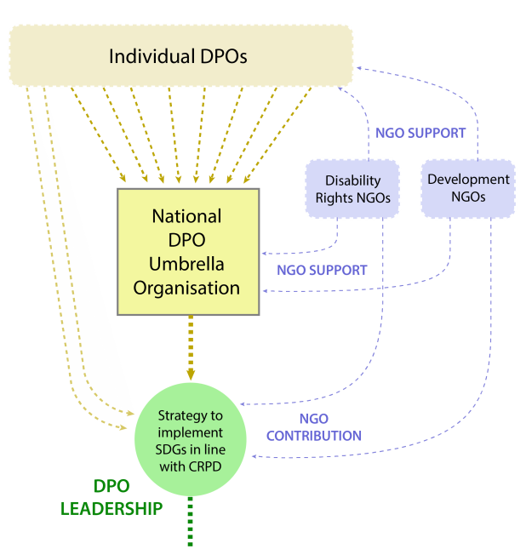
Individual Organizations of Persons with Disabilities (DPOs) join forces, develop a strategy and joint position.
They are supported by disability rights and development NGOs.

Slide 44
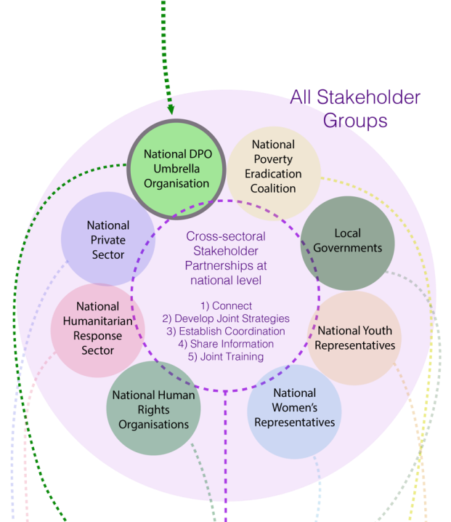
All stakeholder groups join forces to coordinate and strengthen advocacy efforts towards their government. This includes the national disability community. For example, a message could be accessibility for children with disabilities, which would be coordinated with the national you community, national education community, and national health community.

Slide 45
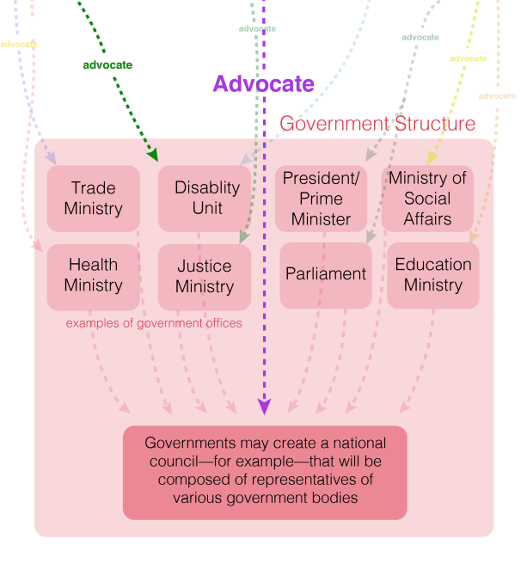
All stakeholder groups advocate the same, coordinated messages to all government offices.
Stakeholders identify which government agency or ministry is responsible for overseeing and coordinating national implementation of the SDGs in order to ensure stakeholder participation.

Slide 46
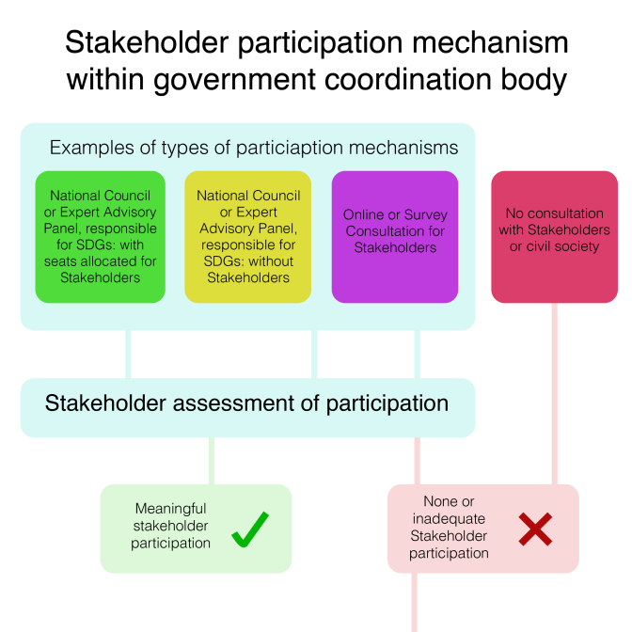

Slide 47
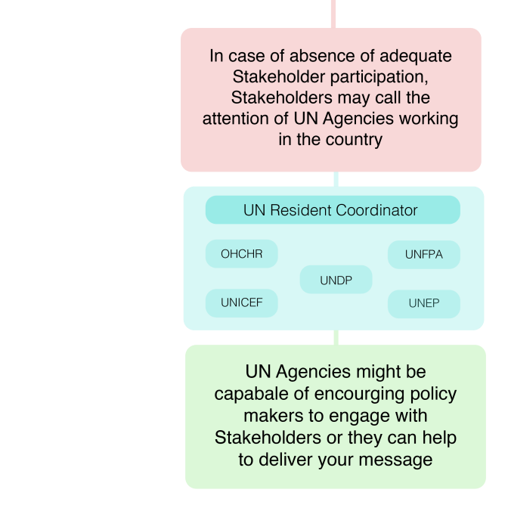

Slide 48
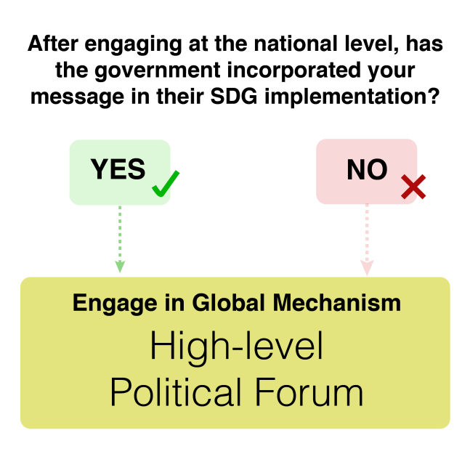

Slide 49
How can persons with disabilities engage in the SDGs?
Raise awareness, share information and coordinate with DPOs and partners
Investigate on existing civil society mechanisms
Reach out to Ministries and Government
Engage in existing civil society mechanisms, and write your own response
Build bridges between national processes and the SDGs and the CRPD

Slide 50
SEVEN
What are the roles of persons with disabilities at the global level?

Slide 51
What are the roles of persons with disabilities at the global level?
Engage with the HLPF
The High-level Political Forum (HLPF) is where the global follow-up and review of the implementation of the SDGs happens
Its purpose is to provide a forum for open, transparent, participative and internationally comparable reviews and proposals
Although not a legally binding accountability mechanism, the global level review provides opportunities for high profile attention and political pressure

Slide 52
What are the roles of persons with disabilities at the global level?
The HLPF is composed of Member States, but is also open to relevant stakeholders, including persons with disabilities.
In order to make better use of their expertise, the UN General Assembly has mandated stakeholders, including persons with disabilities:
  “To attend all official meetings of the forum”
  “To have access to all official information and documents”
  “To intervene in official meetings”
  “To submit documents and present written and oral contributions”
  “To make recommendations”
  “To organize side events and round tables, in cooperation with Member States and the Secretariat”

Slide 53
What are the roles of persons with disabilities at the global level?
The HLPF is the highest forum to raise any issues about SDG implementation related to persons with disabilities.
Persons with disabilities have a mandate to engage in the HLPF in the following areas:
Annual themes
Thematic themes
Country reviews

Slide 54
HLPF Coordination Mechanism
This will ensure persons with disabilities globally participate in the global review and follow-up of the implementation of the SDGs at the HLPF
The coordination mechanism creates an open and transparent manner to all persons with disabilities and their representative organizations to participate and provide input in the annual and thematic themes and national reviews
Share information widely online
Provide an accessible platform that all persons with disabilities can access and provide input

Slide 55
List of references
2030 Agenda sustainabledevelopment.un.org/post2015/transformingourworld
Funding For Development
www.un.org/esa/ffd/ffd3
HLPF Resolution
https://sustainabledevelopment.un.org/hlpf
Beijing Platform for Action
http://beijing20.unwomen.org/en/about
DRR Outcome
http://www.unisdr.org/we/coordinate/sendai-framework

Slide 56



Contact
@iddcconsortium
/IDDCinfo
IDDCconsortium.net
info@iddcconsortium.net
@IDA_CRPD_Forum
/InternationalDisabilityAllianceIDA
InternationalDisabilityAlliance.org
info@ida-secretariat.org
Notes:
All sections are relevant and important, yet the main focus, particularly regarding implementation, seems to center on the sustainable development goals (SDGs).

